Slide 1
Rule 8.00
THE PITCHER

Slide 2
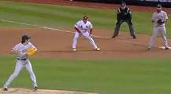
RULE 8.00
8.01
Two legal pitching positions: a) The Windup, and b) The Set
The Pitcher must take his signs from the catcher while engaging the rubber in either position. (Umpires should correct – but no penalty)
Pitcher may properly disengage, but may not step back quickly and deliver a pitch. This could be judged as a quick or illegal pitch.
When disengaging, both hands must be dropped to the sides.

Slide 3
THE WINDUP:
Pitcher stands facing the batter with pivot foot on the plate, and the other foot free.
Any movement associated with the delivery commits the pitcher to pitch w/o interruption – in one continuous motion.
From The Windup Position the pitcher may:
Deliver the ball to the batter
Step toward and throw to a base in an attempt to pick-off a runner
Disengage by stepping off with the pivot foot first – and before any other movements associated with a delivery.
Pitcher may NOT go directly from Windup position to the Set Position. He must first step off properly with the pivot foot first.

Slide 4
THE SET:
Pitcher stands facing the batter with pivot foot on the plate, and the free foot in front of the plate.
With no runners on base, the pitcher need not come to a stop before delivering the pitch.
From The Set Position the pitcher may:
Deliver the ball to the batter - after bringing hands together in front of his body and coming to a complete and discernible stop.
Step directly toward and throw to a base in an attempt to pick-off a runner. Step must be ahead of a throw.
Step backward off the plate with the pivot foot first – and before any other movements associated with a delivery. (Note: By stepping backward off the plate, the pitcher becomes an “infielder” for the purposes of a wild throw. )

Slide 5
8.01 (d):
An illegal pitch is a “ball” with no runners on base (unless the batter reaches 1st base).
An illegal pitch is a “balk” with runners on. (No balks in Majors.)
If a ball slips out of the Pitcher’s hand and crosses the foul line, it is a “ball”. If the ball does not cross the foul line, it is considered “no pitch” with no runners on, or a “balk” with runners on.
8.01 (e):
If the pitcher removes his pivot foot from the pitcher’s plate, the pitcher then becomes an infielder. Therefore, a pickoff attempt that goes out of play would be a 2 base penalty (same as any other fielder).
If the pitcher does not step off, and his pivot foot remains in contact with the rubber, a pickoff throw that goes out of play would be a one base award.

Slide 6
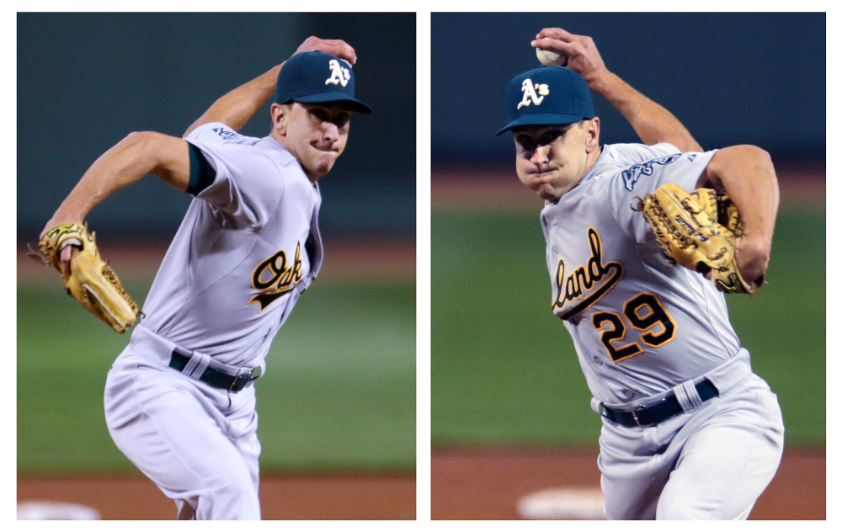
8.01 (f):
A pitcher must visually indicate to the plate umpire, batter, and any/all runners which hand they intend to pitch with. A pitcher must continue to use that hand until the batter is retired, reaches base, the inning ends, or a pinch hitter enters the box.
Pat Venditte

Slide 7
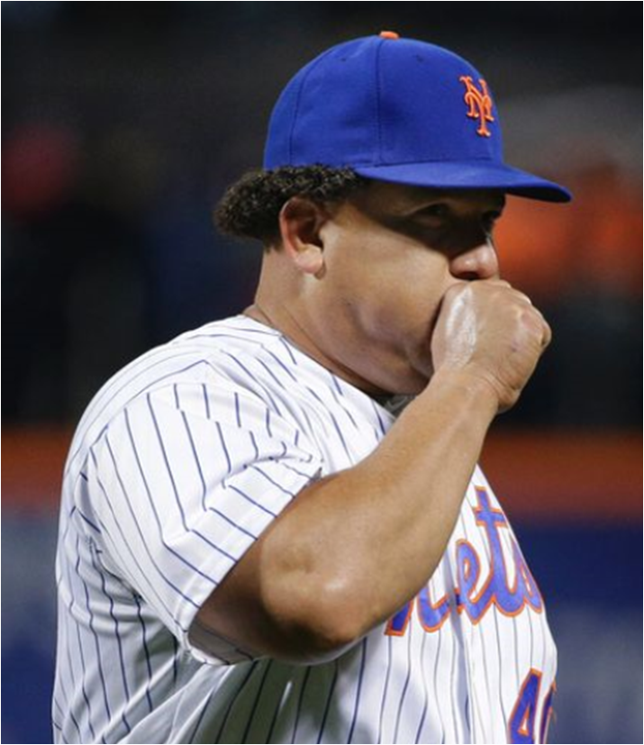
8.02 (a) (1):
Pitching hand must not contact mouth or lips while in the pitcher’s circle. (Cold weather exception – before the game umpires may allow for pitchers to blow on hands).
Penalty: Immediately call a “ball” and warn pitcher that repeated offenses can cause his removal from the game.
Exception: If the pitch is made and the batter and all other runners advance at least one base, the play proceeds w/o reference to the violation.

Slide 8
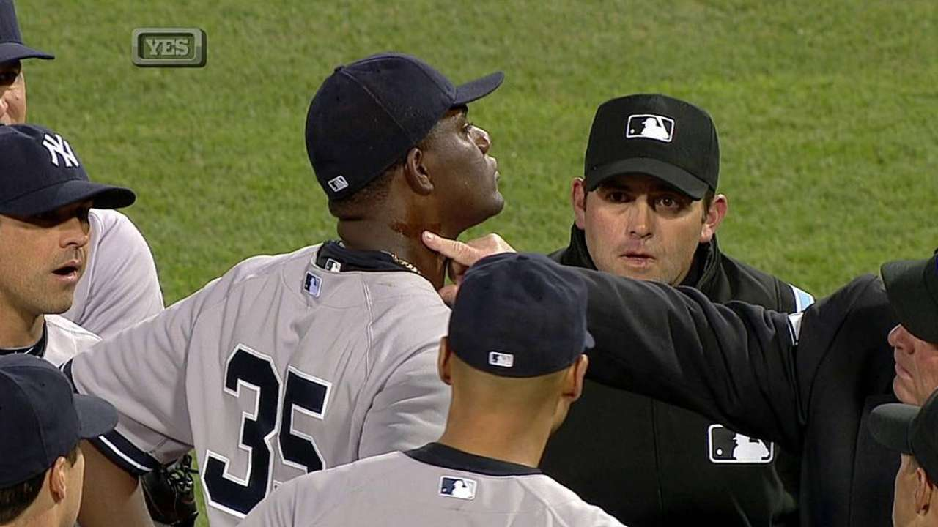
8.02 The Pitcher Shall Not
8.02 (a)
2. Apply a foreign substance of any kind to the ball.

Slide 9
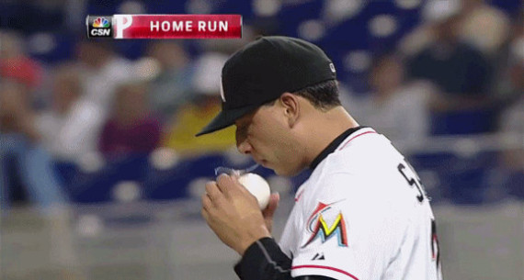
8.02 The Pitcher Shall Not
8.02 (a)
(3)Expectorate (cough/spit) on the ball, hand, or glove.
(4) Rub the ball on the glove person, or clothing.
(5) Deface the ball in any manner
(6) Deliver a shine, spit, mud or emery ball.

Slide 10
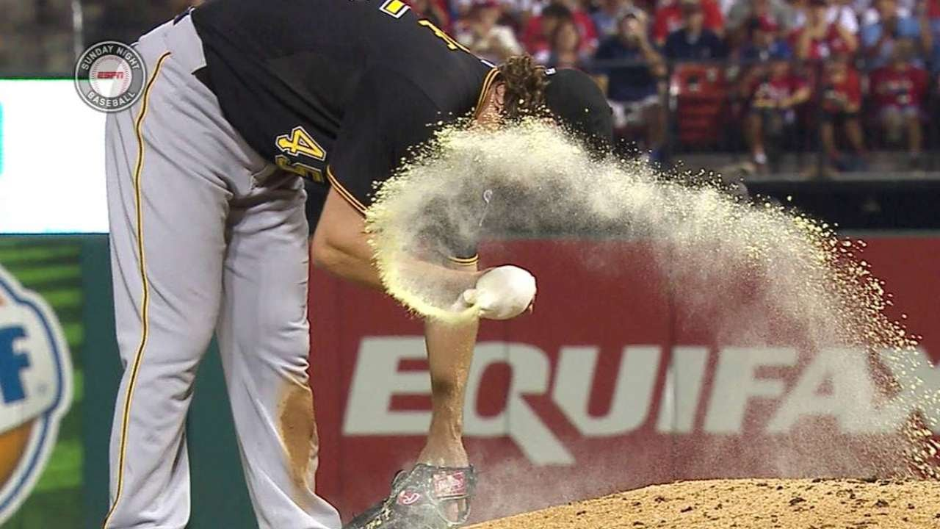
PENALTY: For 8.02 (a) 2-6, call the pitch a ball and warn the pitcher. If a play occurs, the offensive manager may advise the plate umpire of acceptance of the play. Election of the play must occur immediately at the end of the play.
NOTE: Rosin bags are ok. They must be applied to the hand. Not the ball, glove or the uniform.

Slide 11
8.03 – No more than 8 preparatory pitches before an inning begins. Time of these pitches shall not exceed 60 seconds.
“Pitcher, 8 in the first, 5 every other.”
X “Pitcher, how many more do you need?” Answer: “2 more”
“Pitcher, you good to go? Or do you want one more?”
8.04 - When bases are unoccupied, the pitcher shall deliver the ball within 20 seconds after the pitcher receives the ball.
PENALTY: The umpire shall call a ball.
NOTE: Be certain it has been 20 seconds and be prepared to cite the rule. This will result in a discussion.
NOTE: Keep the game moving! Enforcement of this rule could be the difference in a completed or suspended game. It’s imperative that you and your partner in a collective effort do not waste time in between innings and resume play ASAP.

Slide 12
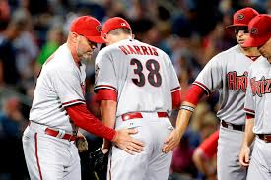
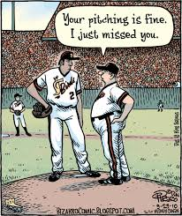
8.06 – Visits to the Mound

Slide 13
8.06 – Visits To The Mound
An individual pitcher must be removed as the pitcher when he is
visited on the mound by any coach for the 3rd time in the same
inning, OR the 4th time in a game.
A manager or coach cannot make a 3rd visit while the same batter is at bat.
Regulation 6-B MAJORS: Once removed from the mound, Pitcher cannot return as the Pitcher in that game. JUNIORS/ SENIORS: If the removed Pitcher stays in the game by going to another Defensive position, he can return as Pitcher once per game. A player who legally re-enters as a pitcher retains the previous pitch count and the number of trips to the mound.

Slide 14
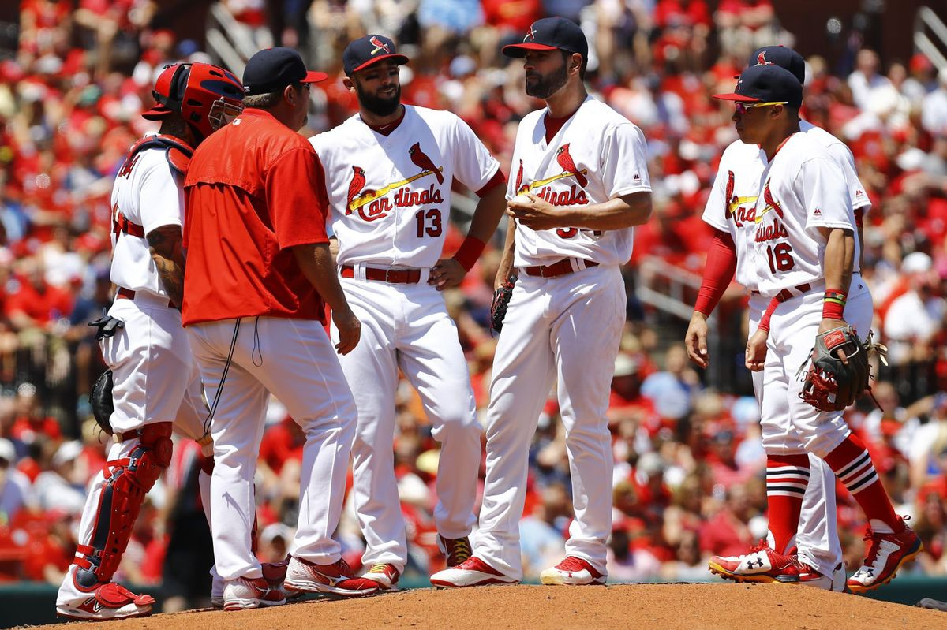
When a manager or coach is granted time to talk to any
defensive players, the pitcher is charged with a visit.
LL interpretation: When a pitcher is removed, the new
pitcher is not charged with a visit.
No visit is charged when a coach wants to check a player
for illness or injury. Umpires need to monitor
conversation and charge defensive visit accordingly

Slide 15
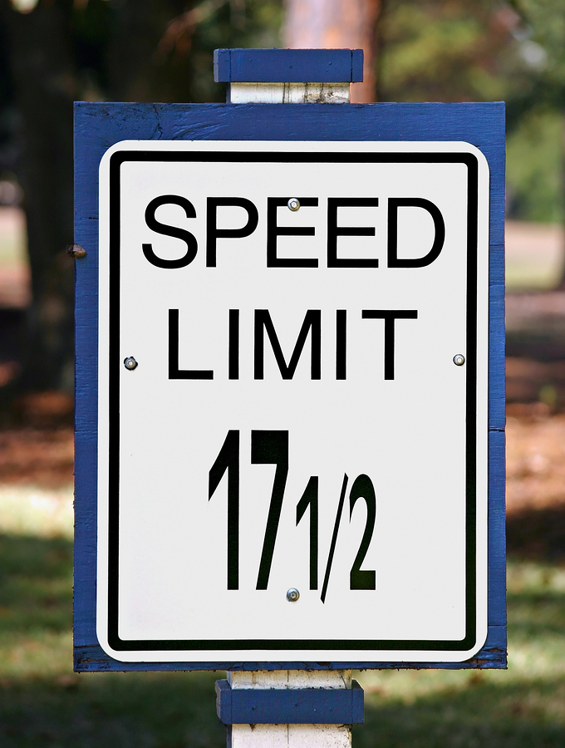
Next Meeting March 2
Mike Messick
Little League* International
New & Obscure Rules

